Slide 1
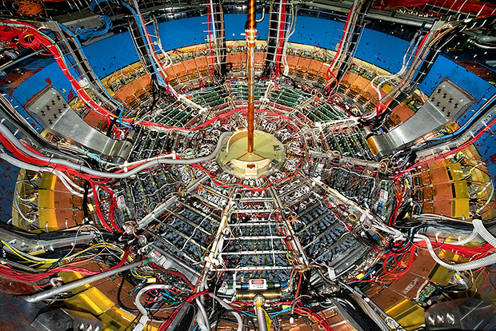
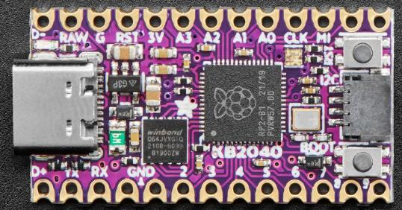
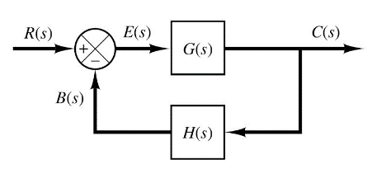

Control Systems
Engineering
(CSE 201)
Student #1
Student #2
Student #3
Team 02
Identify Element
Linear Regression

Slide 2
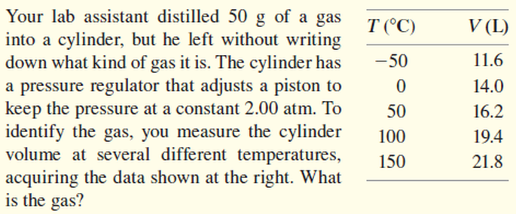
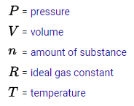
Our Challenge: Identify an Unknown Element
$$PV=nRT$$
SI Units
$$V=\left(\frac{nR}{P}\right)T$$
constant
pascals (Pa)
meters³
$$y=mx$$
constant
constant
$$V=\left(m\right)T$$
kelvin (K)
constant

Slide 3
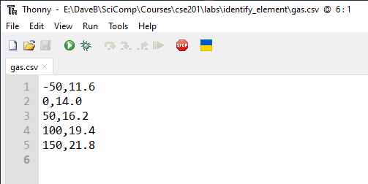
Our Data
CSV = Comma Separated Value (a "text" file)

Slide 4
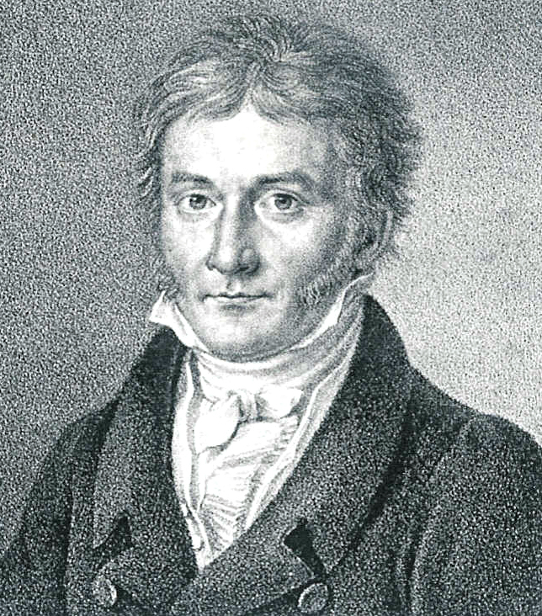
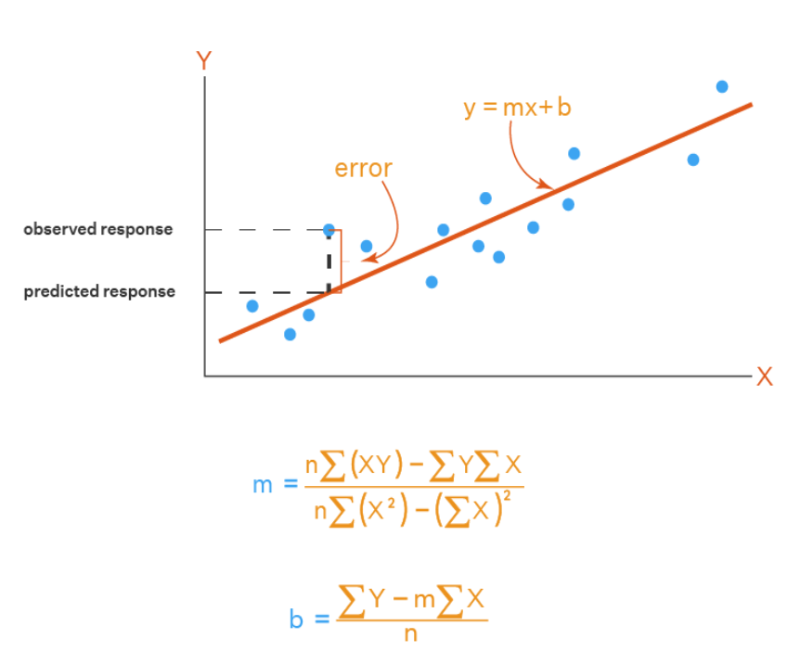
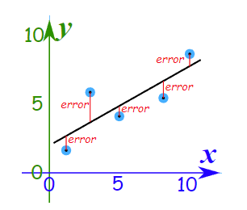
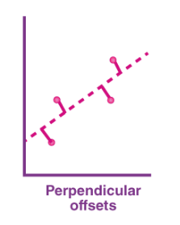
Method of Least Squares
Carl Friedrich Gauss
(1777-1855)

Slide 5
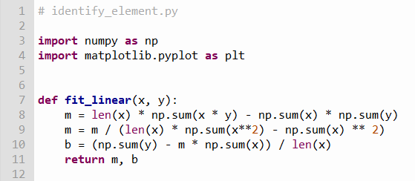

Our Solution
$$y=mx+b$$

Slide 6
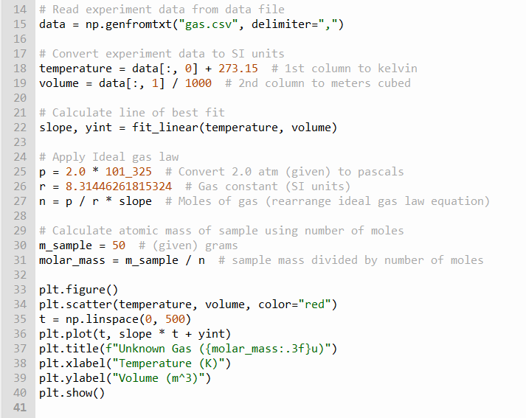



Our Solution
①
②
③
Slope of line of best fit
$$m=\frac{Δy}{Δx}=\frac{V}{T}$$
④
$$PV=nRT$$
$$n=\left(\frac{P}{R}\right)\left(\frac{V}{T}\right)=\frac{P}{R}\left(m\right)$$
⑤
⑥
⑦
⑧
⑨
⑩

Slide 7
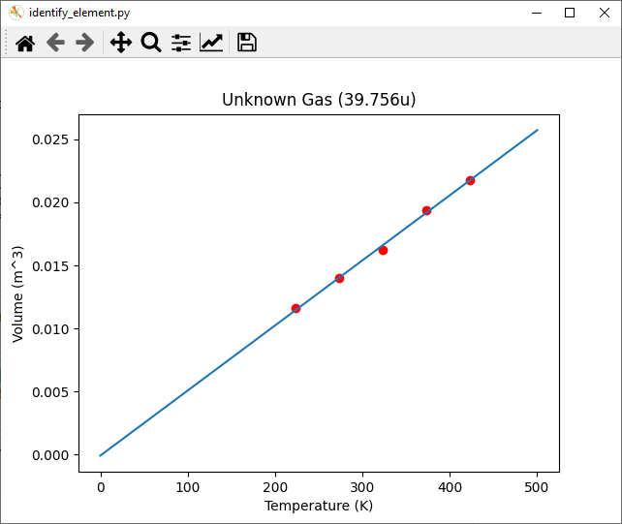
Our Result

Slide 8

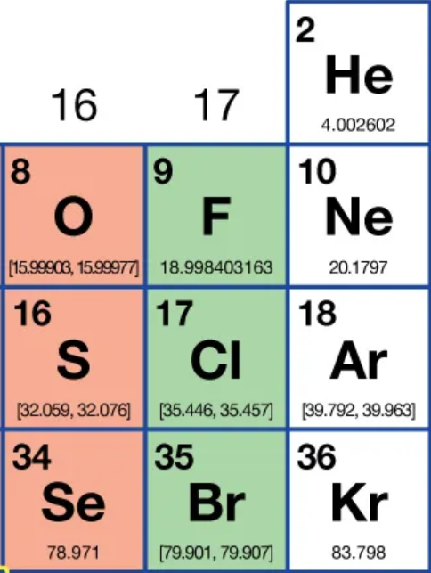
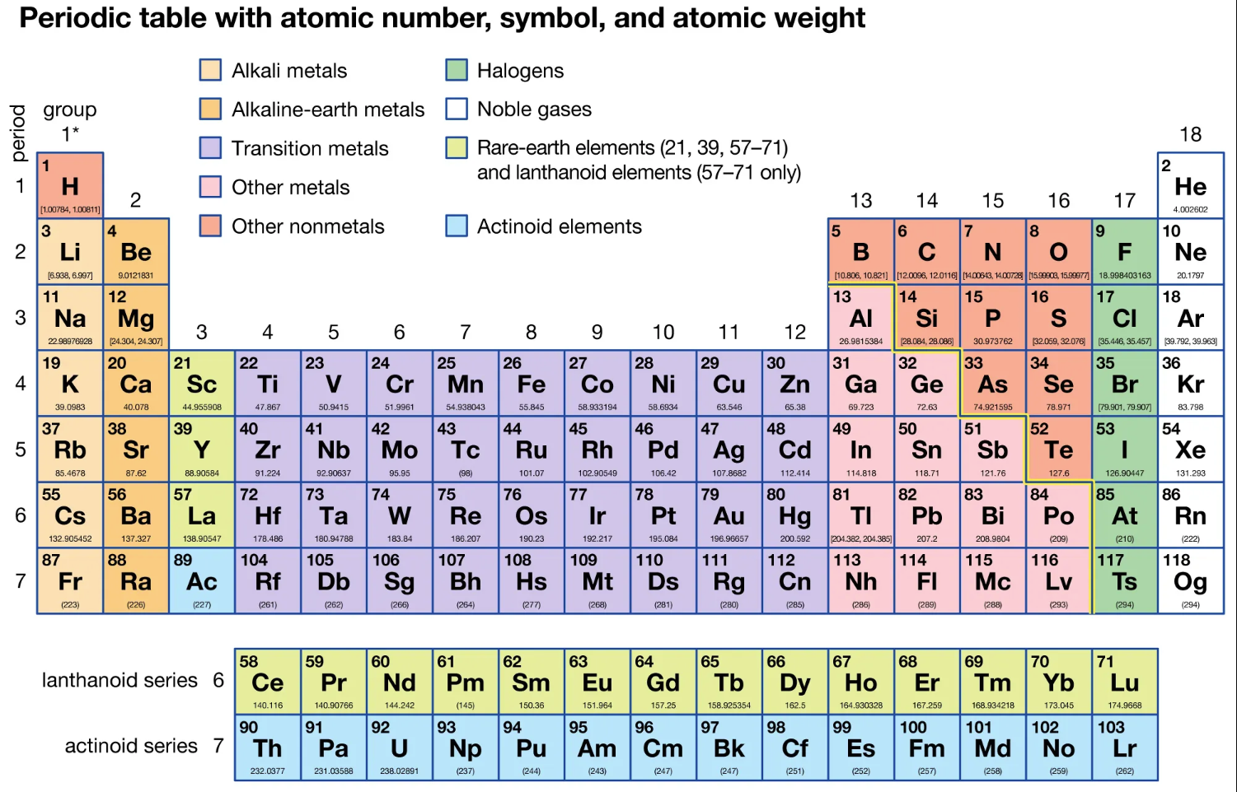

Slide 9

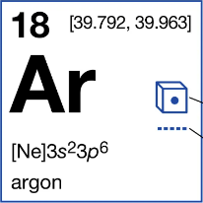
Fun Facts about Argon
Argon is the third-most abundant gas in Earth's atmosphere
It is 2x more abundant than water vapor
It is 23x more abundant than carbon dioxide

Slide 10
Team 02 – What We Learned
How to read CSV data files into a Numpy array
How to find the “line of best fit” through data using the Method of Least Squares
How to use the Ideal Gas Law to determine the identity of an unknown element by calculating its atomic mass

